Slide 1
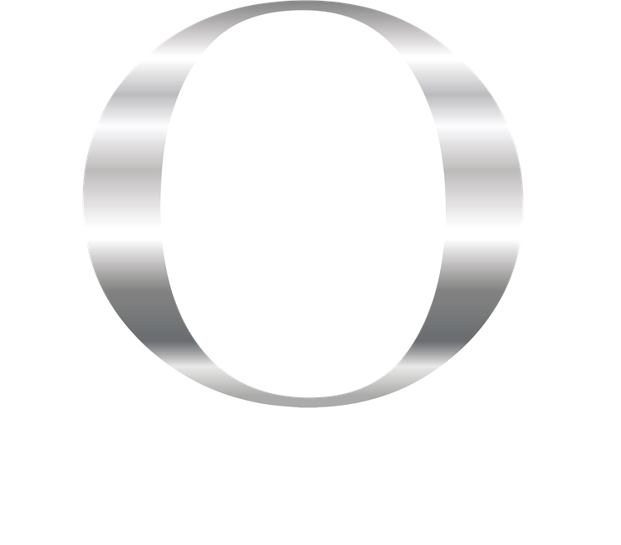
Consent form
Client information:
Name__________________________________________
Date of Birth ____________ Age _____
Address______________________________________________________________________________________________________________________________
Post code____________________________Phone __________________________
Email______________________________________________________________
Procedure: Eyebrow micropigmentation
Procedure Fee £_____________
Informed Consent
The nature and method of the proposed Permanent Make-up (tattoo) procedure has been explained to me as having the usual risks inherent in the procedure and the possibility of complications during and following its performance. I understand there may be a certain amount of discomfort or pain associated with the procedure and that other adverse side effects may include minor and temporary bleeding, bruising, redness or other discolouration and swelling. Fading or loss of pigment may occur. Secondary infection in the area of the procedure may occur, however, if properly cared for, is rare.

Slide 2
I,________________________________, acknowledge by signing below, that I have been given the full opportunity to ask all questions which I might have about the obtaining of any permanent cosmetic procedures from (your name) and/or any associates. I also acknowledge that all of my questions have been answered to my full and total satisfaction.
I specifically acknowledge that I have been advised of the fact and matters set below, and I agree as follows:
• I acknowledge that it is not reasonably possible to determine whether I might have an allergic reaction to any of the pigments, dyes, topical preparations, or processes used in the procedure; and I agree to accept the risk that such a reaction is possible. I have informed the practitioner of any existing problems. _______ (initial)
• I acknowledge that complications are always possible as a result of the permanent make-up procedure, particularly in the event that post-procedural instructions are not followed ______(initial)
• I HAVE DECLARED ALL KNOWN MEDICAL CONDITIONS/ MEDICATION BEFORE UNDERGOING TREATMENT ______(initial)
• I UNDERSTAND/AGREE THAT ……………………………………. WILL NOT BE LIABLE FOR ANY FAILURE ON MY PART TO DECLARE MEDICAL INFORMATION ______(initial) I HAVE RECEIVED A PATCH TEST ______(initial)
• I acknowledge that a 3rd session may be required, added thickness, height difference, unevenness, patchiness, colour fade is NOT our responsibility after healing, as we don't know how your body accepts the pigment, an additional fee of £50 will be added to your 3rd procedure. (please note the fee can change at any time due to work needed to be done and will only be allowed up to 8 weeks after your 2nd procedure.)______ (initial)
• I realise that my body is unique and the practitioner or any of the practitioner’s associates cannot predict how my skin may react as a result of the procedure. _______ (initial)
• Red Heads, blondes & fair skin (Fitz 1-2 skin types) will be red, swollen and pigment MAY not take.
• Additional procedures may be required to obtain desired results. _______(initial)
• Results WILL appear softer as the treated area heals. The area/s treated WILL NOT look as DEFINED or as BOLD as the 1st procedure. _______(initial)

Slide 3
• ALL new procedures require 2 appointments & colour boosts every 6,12,18+ months as we are not responsible on pigment retention to keep the colour fresh. _______(initial)
• I acknowledge & understand that if I have oily/severely oily skin the pigment will heal/appear much softer and can look more solid due the over-production of oil glands. The pigment WILL fade quicker, look blurred or more solid. I accept these risks and would like to proceed. _______(initial)
• Frequent tanning and sun exposure WILL heal darker & fade the pigment quicker. It is recommended to NOT have a tan/burn (30 days before/after) on your face at the time of your procedure.______ (initial)
• I acknowledge & understand that pigment implanted on darker skin types ( i.e. Indian, African American, Filipino etc.), the pigment will appear softer and blend more with your own skins melanin and will not appear as bold or defined as on lighter skin types and the hair strokes will be less visible. _______(initial)
• Alopecia clients- Due to the change in skin texture, pigments may heal more powdered._______(initial)
• I acknowledge that the procedure will result in a permanent change to my appearance and that no representations have been made to me as to later change or remove the result. _______ (initial)
• I understand that skin altering procedures, such as plastic surgery, implants and/or injections may alter and degrade my permanent make-up. I further understand that such changes are not the fault of the practitioner and/or any of the practitioner’s associates. I further understand that such changes in my appearance may not be correctable through further Permanent Make-up procedures. _______ (initial)
• Thyroid Conditions & Medicines, WILL prevent the pigment from retaining, fade quickly or change in colour. I accept these potential risks & wish to proceed. ______(initial)
• For the purposes of education or assistance, I consent to the admittance of authorised observers to the procedure(s). APPROVE_______ (initial) DECLINE______(initial)
• I ACKNOWLEDGE THAT NO GUARANTEES HAVE BEEN MADE TO ME CONCERNING THE RESULTS OF THIS PROCEDURE AND THAT THE PROFESSIONAL RECOMMENDATION IS A NATURAL LOOK. _______ (initial)

Slide 4
• I accept responsibility for determining the colour, shape and position of the brows that will be applied. ______ (initial)
• I understand the actual colour of the pigment may be modified slightly due to the tone and colour of my skin. ______ (initial)
• I acknowledge that the obtaining of Permanent Make-up procedure(s) is by my choice alone, and I consent to the application of the procedure and accept the risks_______ (initial)
• When you leave our clinic, the hair strokes or pigment is intact. How your body heals then is out of the control of the technician. This is 100% your bodies job. Even when following the aftercare fading, blurring or poor retention can still happen depending on your skin & lifestyle. _______(initial)
• In the event of a CAT or MRI scan, please inform your physician of your Iron Oxide Permanent Cosmetics as some pulling or burning sensation (rare) may occur during the procedure. _______(initial)
• I understand that if I do not abide by the strict after care, I can ruin my results. The After Care is crucial for optimum pigment retention. ______(initial)
• Permanent Makeup is an ART, NOT a science. Client’s results will vary and using a pencil or powder may or will still be needed. We have no control over your bodies healing process and each time a procedure is done, the pigment will have less retention due to scar tissue. Touch ups will not be done any sooner than the required time recommended by the technician. _______(initial)
• I accept before and after photos, which may be used for social media, Facebook, Instagram, websites, and any other marketing ACCEPT_______ (initial) / DECLINE _______ (initial)
• NO Refunds after services have been performed.______(initial)
• I understand that at a certain point as the skin ages, PMU will no longer be an option. _______(initial)
• Are you pregnant, nursing or trying (IVF) to get pregnant? (Circle) YES or NO, I DON’T KNOW (If you circle, no or I don’t know, services can not be performed).
• I understand that the pigment will look sharper, bolder, darker and thicker and can remain like this up to 28 days of healing _______ (initial)

Slide 5
• I Am Happy with the results of my First Procedure and will follow aftercare strictly _______(initial)
• I Approve of my brow template design and I am happy with the shape to be tattooed (to be signed during procedure ) _______ (initial)
PERMANENT MAKEUP BY …………………………………….. CAN RELEASE ME AT ANY TIME FROM ANY FUTURE SERVICES IF SHE FEELS POLICIES OR PROCEDURES ARE NOT FOLLOWED _______ (initial)
I HAVE RECEIVED A COPY OF THE AFTER CARE INSTRUCTIONS ______(initial)
I have read and fully understand the contents of each paragraph above. I acknowledge this is a legal & binding contract and that I have received no warranties or guarantees with respect to the benefits to be realised from or consequences of, the aforementioned procedure(s). I further acknowledge that at the time of signing this consent to this procedure(s), I was of sound mind and capable of making independent decisions for myself.
Client Signature: ______________________________________
Technician name: _____________________________________
Date: ______________________

